Slide 1
How to use the RHS 'Find a plant' tool
A step-by-step guide

Slide 2
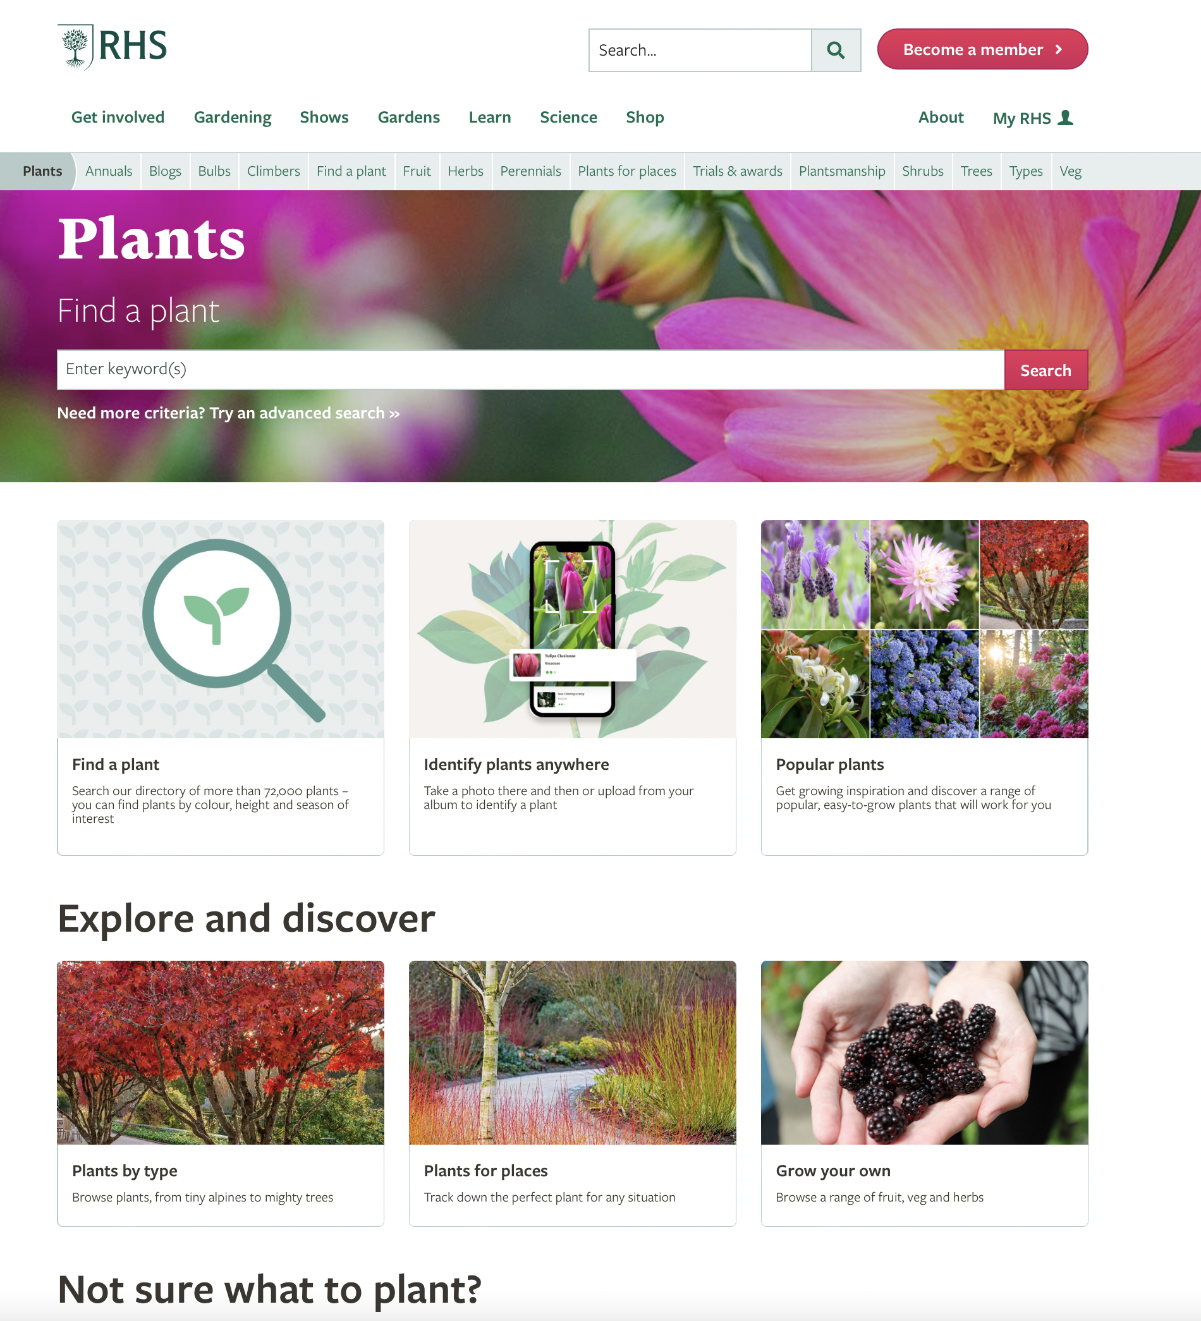
On a web browser, go to www.rhs.org.uk/plants
The page will look something like this.
To use the search tool, click on the Find a plant button, or Try an advanced search.

Slide 3
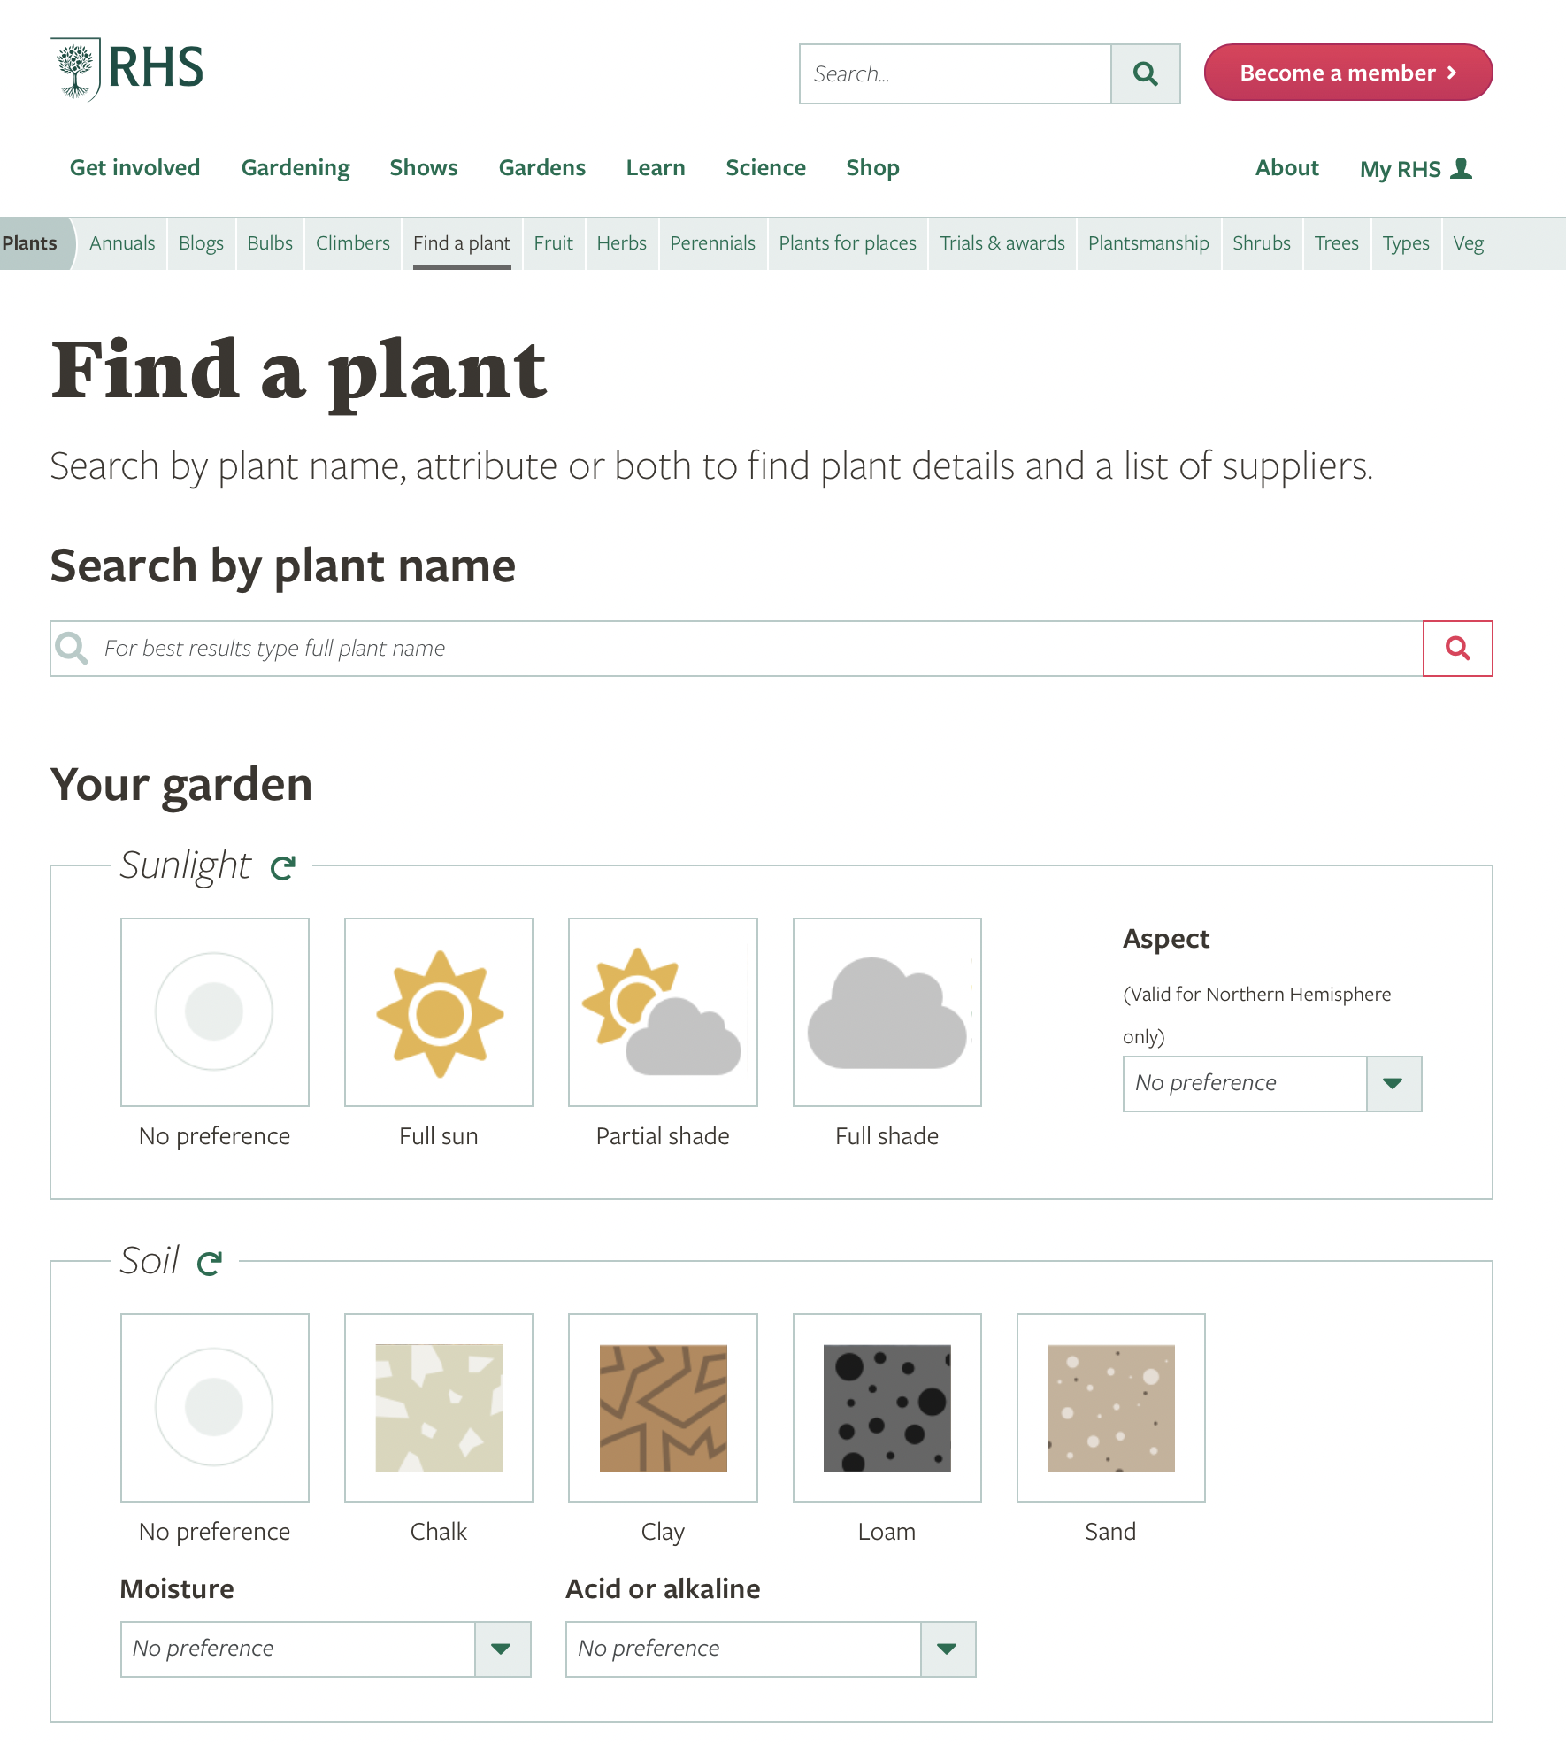
2. The ‘Find a plant’ page looks like this:
This form gives you lots of options to select what plants you are looking for.
You don’t have to use all of them, but the more information you know about your space, the better!
The following pages will guide you through the key areas to help your search.

Slide 4
Sunlight
Is the area you are looking to plant in full sun, partial shade or full shade?
Aspect: What way does it face? (North, East, South or West – this affects the amount of sunlight and warmth your space gets)
1
2
Warm up: Try selecting a sunny, south-facing garden

Slide 5
Soil
3. What texture is your soil? Try doing a soil texture test to find out!
4. Moisture: How well does the soil drain? Is it often wet and boggy after rain (poorly-drained)? Does water drain away quickly (well-drained)?
3
Warm up: Select loamy soil, that is moist but well-drained
4

Slide 6
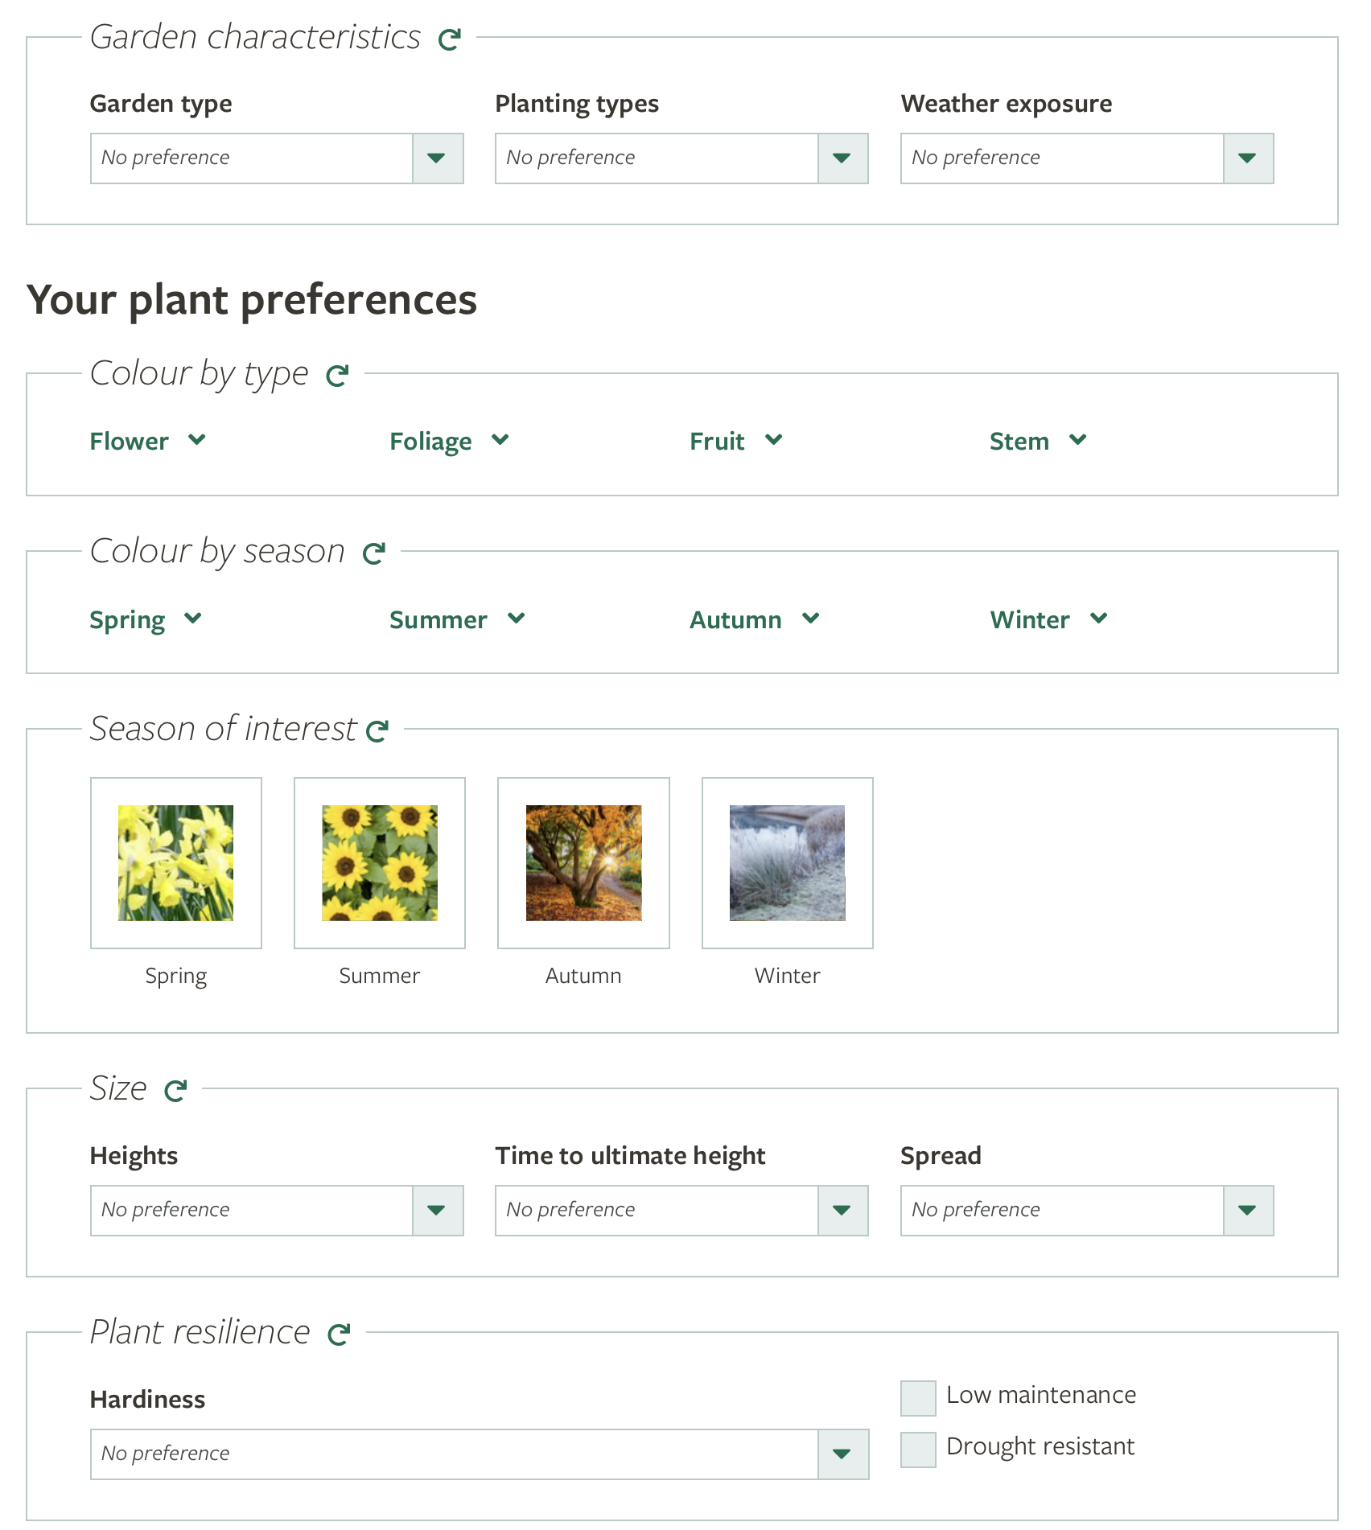
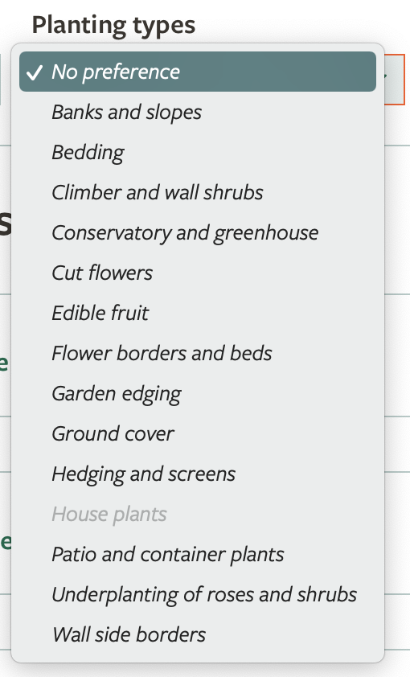
Planting types
5
5. If you know what sort of planted area you'd like to create, you can select it in the Planting types drop-down menu.
e.g. climbers for a green wall, hedges, plants for containers, fruit plants, or flower beds.
Warm up: Select the planting type for flower borders and beds

Slide 7
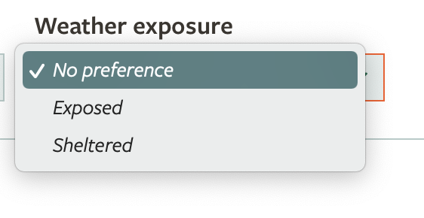
Weather exposure
6. Is your space sheltered from the wind and rain, or open and exposed? If you know this, you can select 'Exposed' or 'Sheltered' from the Weather exposure drop-down menu.
6
Warm up: Select ‘exposed’

Slide 8
Colour and season
7. If you have colours in mind, or a season when you'd like the plants to be at their best, you can use these menus...
But remember, the most important thing is that the plants are helpful to wildlife and supporting nature on your site.
7
Warm up: Select purple and yellow flowers

Slide 9
Size
If you are looking for plants that are tall (to provide shade, shelter or screening) or small (because of limited space), you can use the menus in this section.
8. Height: how tall the plant can grow
9. Time to ultimate height: how long it takes for the plant to reach its full size
10. Spread: how wide the plant can get
9
10
8
Warm up: Try looking for plants that will grow 0.5-1 metre tall

Slide 10
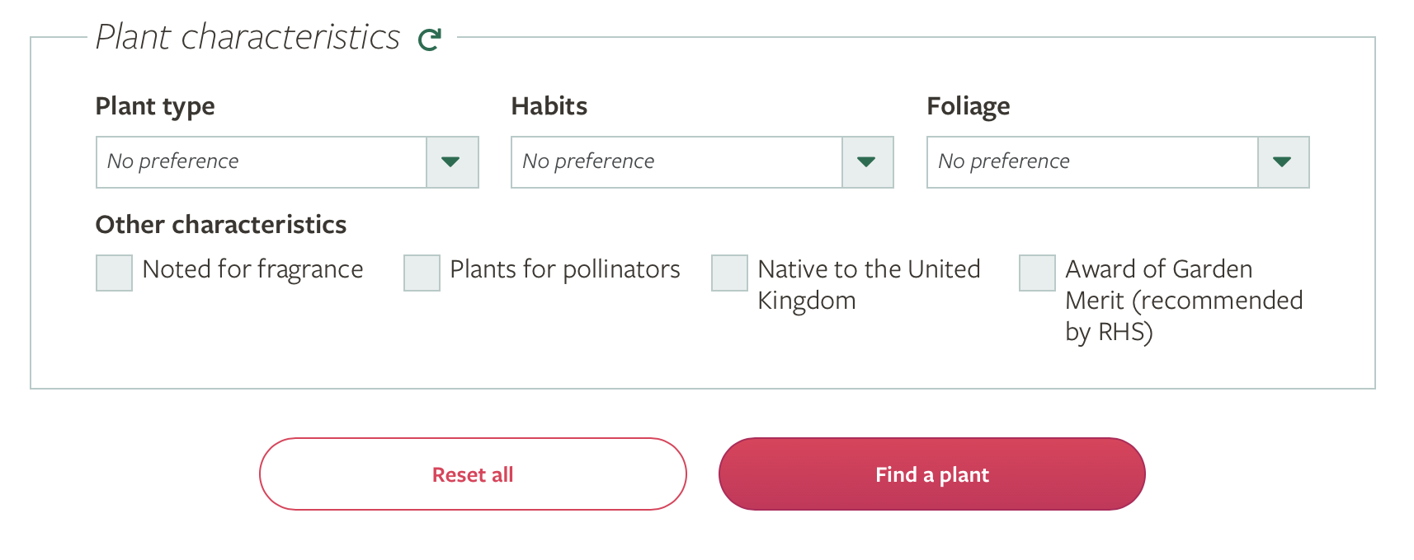
Plant characteristics
11. If you know what sort of plant you are looking for, use the Plant type drop-down menu to select it e.g. ferns, grasses, herbs, shrubs, trees.
12. Finally, click Find a plant to see your results!
11
Warm up: Select annual and biennial plant types
12

Slide 11
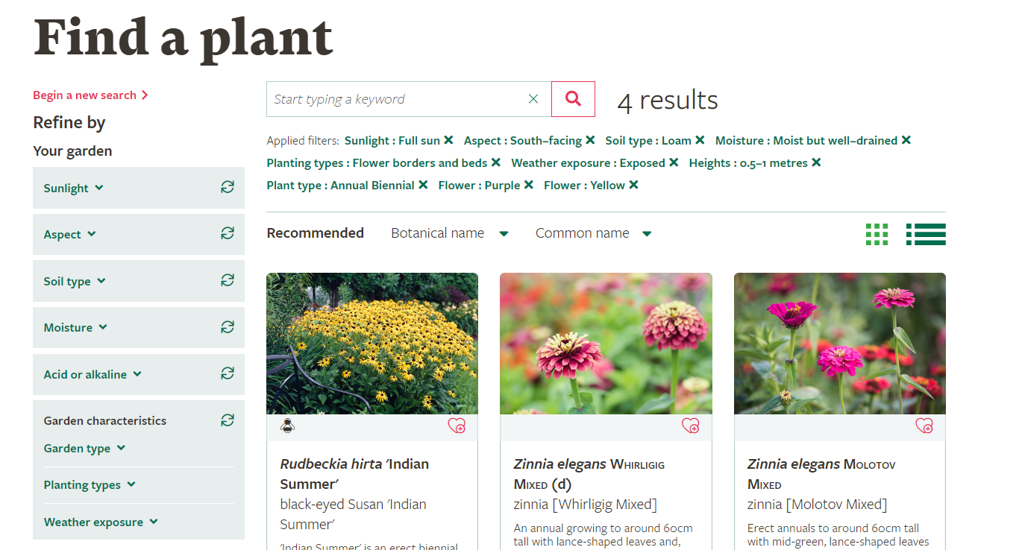
Viewing your results
You will then see results of plants that match your selected criteria.
The image on the right shows plant results from following the warm-up prompts. Did you end up with the same results?
These results display 4 plants that are best suited for a south-facing, exposed flower bed in full sun, with loamy, moist but well-drained soil. The plants are annual or biennial with purple or yellow flowers and can grow to a height of 0.5-1 metre.

Slide 12
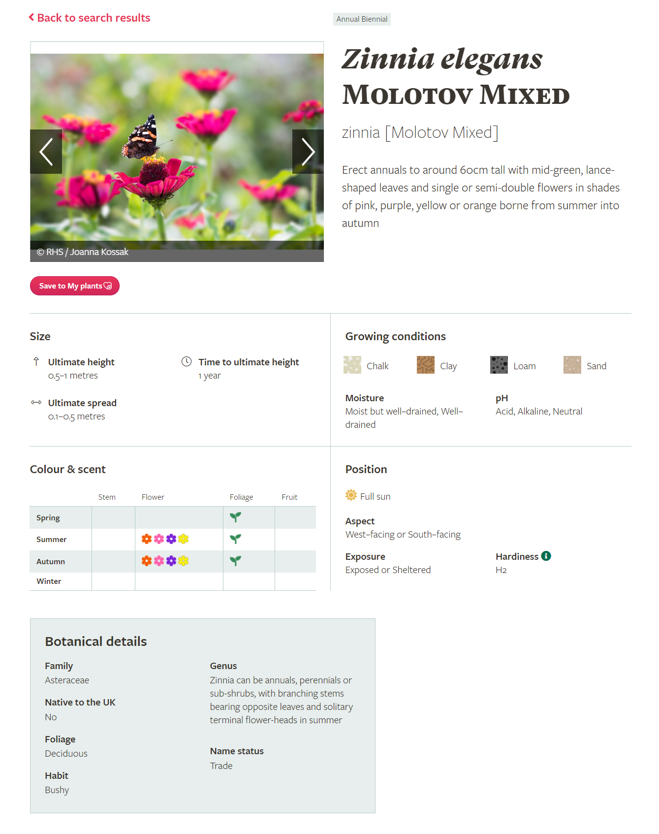
Viewing your results
Clicking on a plant will then show you more information about it, including its size, growing conditions, and months it will have flowers and/or fruit.
Try out this tool to find plants suitable for your Nature Park!

